Slide 1
Chapter 2
How to write your first programs

Slide 2
Applied objectives
Use the IDLE shell to test numeric and string operations.
Code, test, and debug programs that require the skills that you’ve learned in this chapter. That includes the use of:
comments for documenting your code and commenting out statements str, int, and float values and variables arithmetic expressions string concatenation special characters in strings the built-in print(), input(), str(), float(), int(), and round() functions function chaining

Slide 3
Knowledge objectives (part 1)
Describe the use of indentation when coding Python statements.
Describe the use of Python comments, including “commenting out” portions of Python code.
Describe these data types: str, int, float.
List two recommendations for creating a Python variable name.
Distinguish between underscore notation and camel case.
Describe the evaluation of an arithmetic expression, including order of precedence and the use of parentheses.
Distinguish among these arithmetic operators: /, //, and %.
Describe the use of += operator in a compound arithmetic expression.
Describe the use of escape sequences when working with strings.

Slide 4
Knowledge objectives (part 2)
Describe the syntax for calling one of Python’s built-in functions.
Describe the use of the print(), input(), str(), float(), int(), and round() functions.
Describe what it means to chain functions.

Slide 5
The Python code for a Test Scores program
#!/usr/bin/env python3
counter = 0
score_total = 0
test_score = 0
while test_score != 999:
test_score = int(input("Enter test score: "))
if test_score >= 0 and test_score <= 100:
score_total += test_score
counter += 1
average_score = round(score_total / counter)
print("Total Score: " + str(score_total))
print("Average Score: " + str(average_score))

Slide 6
An indentation error
print("Total Score: " + str(score_total))
print("Average Score: " + str(average_score))

Slide 7
Two ways to continue one statement over two or more lines
Implicit continuation
print("Total Score: " + str(score_total)
+ "\nAverage Score: " + str(average_score))
Explicit continuation
print("Total Score: " + str(score_total) \
+ "\nAverage Score: " + str(average_score))

Slide 8
Coding rules
Python relies on proper indentation. Incorrect indentation causes an error.
The standard indentation is four spaces.
With implicit continuation, you can divide statements after parentheses, brackets, and braces, and before or after operators like plus or minus signs.
With explicit continuation, you can use the \ character to divide statements anywhere in a line.

Slide 9
The Test Scores program with comments (part 1)
#!/usr/bin/env python3
# This is a tutorial program that illustrates the use of
# the while and if statements
# initialize variables
counter = 0
score_total = 0
test_score = 0
# get scores
while test_score != 999:
test_score = int(input("Enter test score: "))
if test_score >= 0 and test_score <= 100:
score_total += test_score # add score to total
counter += 1 # add 1 to counter

Slide 10
The Test Scores program with comments (part 2)
# calculate average score
#average_score = score_total / counter
#average_score = round(average_score)
average_score = round( # implicit continuation
score_total / counter) # same results as
# commented out statements
# display the result
print("======================")
print("Total Score: " + str(score_total) # implicit cont.
+ "\nAverage Score: " + str(average_score))

Slide 11
Guidelines for using comments
Use comments to describe portions of code that are hard to understand, but don’t overdo them.
Use comments to comment out (or disable) statements that you don’t want to test.
If you change the code that’s described by comments, change the comments too.

Slide 12
The syntax for calling any function
function_name([arguments])
The print() function
print([data])
A script with three statements
print("Hello out there!")
print()
print("Goodbye!")
The console after the program runs
Hello out there!
Goodbye!

Slide 13
Three Python data types
Data type Name Examples
str String "Mike" "40" 'Please enter name: '
int Integer 21 450 0 -25
float Floating-point 21.9 450.25 0.01 -25.2 3.1416

Slide 14
Code that initializes variables and assigns data
first_name = "Mike" # sets first_name to a str of "Mike"
quantity1 = 3 # sets quantity1 to an int of 3
quantity2 = 5 # sets quantity2 to an int of 5
list_price = 19.99 # sets list_price to a float of 19.99
Code that assigns new data to the variables above
first_name = "Joel" # sets first_name to a str of "Joel"
quantity1 = 10 # sets quantity1 to an int of 10
quantity1 = quantity2 # sets quantity1 to an int of 5
quantity1 = "15" # sets quantity1 to a str of "15"
Code that causes an error due to incorrect case
quantity1 = Quantity2 # NameError: 'Quantity2' is not defined

Slide 15
How to code literal values
To code a literal value for a string, enclose the characters of the string in single or double quotation marks. This is called a string literal.
To code a literal value for a number, code the number without quotation marks. This is called a numeric literal.

Slide 16
Rules for naming variables
A variable name must begin with a letter or underscore.
A variable name can’t contain spaces, punctuation, or special characters other than the underscore.
A variable name can’t begin with a number, but can use numbers later in the name.
A variable name can’t be the same as a keyword that’s reserved by Python.

Slide 17
Python keywords
and except lambda while
as False None with
assert finally nonlocal yield
break for not
class from or
continue global pass
def if raise
del import return
elif in True
else is try

Slide 18

Two naming styles for variables
variable_name # underscore notation
variableName # camel case
Recommendations for naming variables
Start all variable names with a lowercase letter.
Use underscore notation or camel case.
Use meaningful names that are easy to remember.
Don’t use the names of built-in functions, such as print().

Slide 19
Python’s arithmetic operators
Operator Name
+ Addition
- Subtraction
* Multiplication
/ Division
// Integer division
% Modulo / Remainder
** Exponentiation

Slide 20
Examples with two operands
Example Result
5 + 4 9
25 / 4 6.25
25 // 4 6
25 % 4 1
3 ** 2 9

Slide 21
The order of precedence
Order Operators Direction
1 ** Left to right
2 * / // % Left to right
3 + - Left to right

Slide 22
Examples that show the order of precedence and use of parentheses
Example Result
3 + 4 * 5 23 (the multiplication is done first)
(3 + 4) * 5 35 (the addition is done first)

Slide 23
Code that calculates sales tax
subtotal = 200.00
tax_percent = .05
tax_amount = subtotal * tax_percent # 10.0
grand_total = subtotal + tax_amount # 210.0
Code that calculates the perimeter of a rectangle
width = 4.25
length = 8.5
perimeter = (2 * width) + (2 * length) # 25.5

Slide 24
The most useful compound assignment operators
+=
-=
*=
Two ways to increment the number in a variable
counter = 0
counter = counter + 1 # counter = 1
counter += 1 # counter = 2
Code that adds two numbers to a variable
score_total = 0 # score_total = 0 score_total += 70 # score_total = 70 score_total += 80 # score_total = 150

Slide 25
More compound assignment operator examples
total = 1000.0
total += 100.0 # total = 1100.0
counter = 10
counter -= 1 # counter = 9
price = 100
price *= .8 # price = 80.0

Slide 26
A floating-point result that isn’t precise
subtotal = 74.95 # subtotal = 74.95
tax = subtotal * .1 # tax = 7.495000000000001

Slide 27
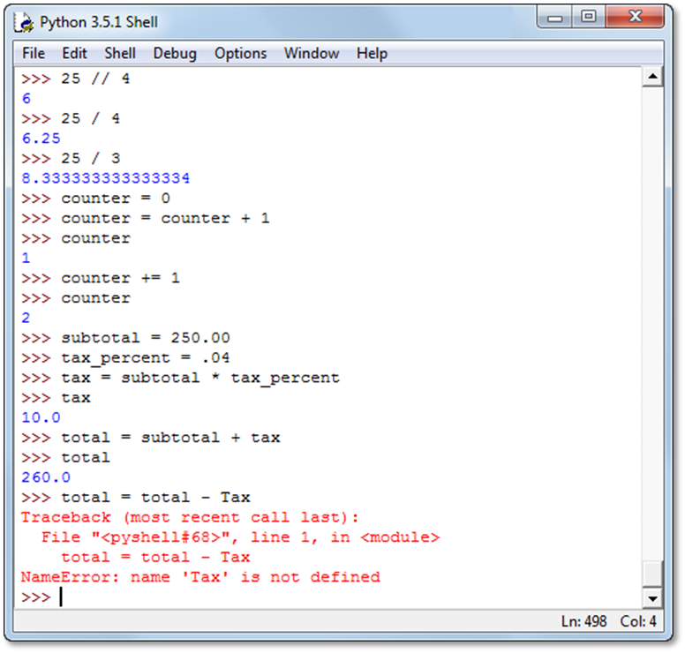
The Python shell after some numeric testing

Slide 28
How to use the shell
To test a statement, type it at the prompt and press the Enter key. You can also type the name of a variable at the prompt to see what its value is.
Any variables that you create remain active for the current session. As a result, you can use them in statements that you enter later in the same session.
To retype your previous entry, press Alt+p (Windows) or Command+p (OS X).
To cycle through all of the previous entries, continue pressing the Alt+p (Windows) or Command+p (OS X) keystroke until the entry you want is displayed at the prompt.

Slide 29
How to assign strings to variables
first_name = "Bob" # Bob
last_name = 'Smith' # Smith
name = "" # (empty string)
name = "Bob Smith" # Bob Smith
How to join three strings with the + operator
name = last_name + ", " + first_name # Smith, Bob

Slide 30
The str() function
str(data)
How to join a string and a number
name = "Bob Smith"
age = 40
message = name + " is " + str(age) + " years old."
What happens if you don’t use the str() function
message = name + " is " + age + " years old."
Traceback (most recent call last):
File "<pyshell#33>", line 1, in <module>
message = name + " is " + age + " years old."
TypeError: Can't convert 'int' object to str implicitly

Slide 31
Common escape sequences
Sequence Character
\n New line
\t Tab
\r Return
\" Quotation mark in a double quoted string
\' Quotation mark in a single quoted string
\\ Backslash

Slide 32
The new line character
print("Title: Python Programming\nQuantity: 5")
Displayed on the console
Title: Python Programming
Quantity: 5
The tab and new line characters
print("Title:\t\tPython Programming\nQuantity:\t5")
Displayed on the console
Title: Python Programming
Quantity: 5

Slide 33
The backslash in a Windows path
print("C:\\murach\\python")
Displayed on the console
C:\murach\python
Four ways to include quotation marks in a string
"Type \"x\" to exit" # String is: Type "x" to exit.
'Type \'x\' to exit' # String is: Type 'x' to exit.
"Type 'x' to exit" # String is: Type 'x' to exit.
'Type "x" to exit' # String is: Type "x" to exit.

Slide 34
Implicit continuation of a string over several lines
print("Total Score: "
+ str(score_total)
+ "\nAverage Score: "
+ str(average_score))

Slide 35
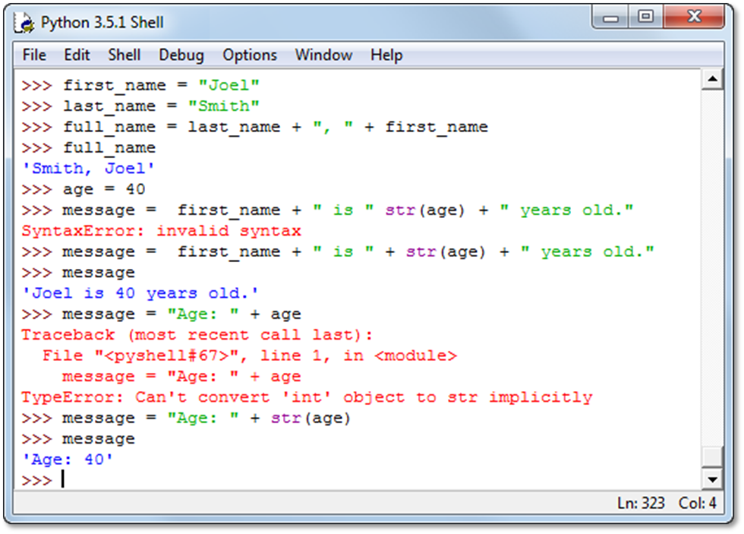
The Python shell with string testing

Slide 36
Review of how to use the shell
To test a statement, type it at the prompt and press the Enter key. You can also type the name of a variable at the prompt to see what its value is.
Any variables that you create remain active for the current session. As a result, you can use them in statements that you enter later in the same session.
To retype the previous statement on Windows, press Alt+p. To cycle through all of the previous statements, continue pressing Alt+p. On OS X, use Command+p.

Slide 37
The syntax of the print() function
print(data[, sep=' '][, end='\n'])
Three print() functions
print(19.99) # 19.99
print("Price:", 19.99) # Price: 19.99
print(1, 2, 3, 4) # 1 2 3 4

Slide 38
Two ways to get the same result
A print() function that receives four arguments
print("Total Score:", score_total,
"\nAverage Score:", average_score)
A print() function that receives one string as the argument
print("Total Score: " + str(score_total) +
"\nAverage Score: " + str(average_score))
The data that’s displayed by both functions
Total Score: 240
Average Score: 80

Slide 39
Examples that use the sep and end arguments
print(1,2,3,4,sep=' | ') # 1 | 2 | 3 | 4
print(1,2,3,4,end='!!!') # 1 2 3 4!!!

Slide 40
The input() function
input([prompt])
Code that gets string input from the user
first_name = input("Enter your first name: ")
print("Hello, " + first_name + "!")
The console
Enter your first name: Mike
Hello, Mike!

Slide 41
Another way to get input from the user
print("What is your first name?")
first_name = input()
print("Hello, " + first_name + "!")
The console
What is your first name?
Mike
Hello, Mike!

Slide 42
Code that attempts to get numeric input
score_total = 0
score = input("Enter your score: ")
score_total += score # causes an error
# because score is a string

Slide 43
Three functions for working with numbers
int(data)
float(data)
round(number [,digits])
Code that causes an exception
x = 15
y = "5"
z = x + y # TypeError: can't add an int to a str
How using the int() function fixes the exception
x = 15
y = "5"
z = x + int(y) # z is 20

Slide 44
Code that gets an int value from the user
quantity = input("Enter the quantity: ") # get str type
quantity = int(quantity) # convert to int type
How to use chaining to get the value in one statement
quantity = int(input("Enter the quantity: "))

Slide 45
Code that gets a float value from the user
price = input("Enter the price: ") # get str type
price = float(price) # convert to float type
How to use chaining to get the value in one statement
price = float(input("Enter the price: "))

Slide 46
Code that uses the round() function
miles_driven = 150
gallons_used = 5.875
mpg = miles_driven / gallons_used # 25.53191489361702
mpg = round(mpg, 2) # 25.53
How to combine the last two statements
mpg = round(miles_driven / gallons_used, 2)

Slide 47
The console for the Miles Per Gallon program
The Miles Per Gallon program
Enter miles driven: 150
Enter gallons of gas used: 35.875
Miles Per Gallon: 4.18
Bye

Slide 48
The code for the Miles Per Gallon program
#!/usr/bin/env python3
# display a title
print("The Miles Per Gallon program")
print()
# get input from the user
miles_driven= float(input("Enter miles driven:\t\t"))
gallons_used = float(input("Enter gallons of gas used:\t"))
# calculate and round miles per gallon
mpg = miles_driven / gallons_used
mpg = round(mpg, 2)
# display the result
print()
print("Miles Per Gallon:\t\t" + str(mpg))
print()
print("Bye")

Slide 49
The console for the Test Scores program
The Test Scores program
Enter 3 test scores
======================
Enter test score: 75
Enter test score: 85
Enter test score: 95
======================
Total Score: 255
Average Score: 85
Bye

Slide 50
The code for the Test Scores program
#!/usr/bin/env python3
# display a title
print("The Test Scores program")
print()
print("Enter 3 test scores")
print("======================")
# get scores from the user and accumulate the total
total_score = 0 # initialize the total_score variable
total_score += int(input("Enter test score: "))
total_score += int(input("Enter test score: "))
total_score += int(input("Enter test score: "))
# calculate average score
average_score = round(total_score / 3)
# format and display the result
print("======================")
print("Total Score: ", total_score,
"\nAverage Score:", average_score)
print()
print("Bye")

